Slide 1
WildFire Forest Detection Using Deep Learning Final Team ID: 10
S.No | Reg.No | Name of the Student | Branch & Section
1 | BL.EN.U4CSE20163 | Sreya Chowdary Karuturi | C
2 | BL.EN.U4CSE20185 | Tunuguntla Aasritha Srivani | C
3 | BL.EN.U4CSE20189 | Vadlamudi Krishna Sowgandhi | C
Project Guide: Dr. Rimjhim Singh
Assistant Professor (Sr.Gr.), Department of Computer Science Engineering, Amrita School of Computing, Bengaluru

Slide 2
Problem Definition
Our work is to generate a model using Deep Learning techniques which correctly classifies the wildfire RGB images into three categories i.e.., Fire, smoke, non-smoke.

Slide 3
Literature Survey
S.No. | Authors name(s) | Full title of the paper with year | Inference from the paper | Open Problem (For proposed work)
1 | Tsalera | CNN-Based Systems for Wildfire Detection and Classification | Investigates CNN-based systems for wildfire detection, highlighting the efficacy of lightweight CNNs for accurate classification under varying noise levels. | Expanding the dataset for broader applications and exploring larger network architectures for increased noise tolerance.
2 | Chen | Drone-Based Deep Learning for Early Wildfire Detection | Utilizes drones and deep learning to identify fire and smoke pixels, enhancing accuracy and rapidity in fire detection. | Integration of thermal cameras for improved fire detection and accounting for diverse terrains for comprehensive monitoring.
3 | Richard, Jacobo | Quadcopter-Based Wildfire Inspection and Geolocation Estimation | Introduces a comprehensive architecture using drones for wildfire detection, estimation, and communication, showcasing potential for informed decision-making during fire response | Integrating thermal cameras to enhance fire detection accuracy, accommodating varied terrains, and improving efficacy in wildfire monitoring and response.

Slide 4
Literature Survey
S.No. | Authors name(s) | Full title of the paper with year | Inference from the paper | Open Problem (For proposed work)
4 | Mengan, Youmin | Enhanced Real-Time Fire Segmentation Using MobileNetV3 | Proposes an improved fire segmentation method leveraging MobileNetV3, achieving higher processing speed with enriched fire-specific features. | Exploring methods to balance speed and accuracy in fire segmentation tasks.
5 | Jingguo, Xiaochuan | RGB-IR Feature Fusion for Accurate Flame Identification | Presents a Flame Identification system utilizing RGB-IR fusion, outperforming existing models and enhancing precision in woodland fire detection.. | Researching parallel training strategies to reduce training time and expanding the dataset for diverse situations.

Slide 5
Justification for the Proposed Problem
The accurate classification of wildfire RGB images into Fire, Smoke, and Non-Smoke categories using Deep Learning techniques holds immense importance.
This task empowers rapid disaster response by enabling swift identification and assessment of wildfire intensity and spread.
Beyond immediate crisis management, it aids in environmental monitoring, offering insights into fire behavior and facilitating informed decisions for conservation efforts.
Furthermore, it plays a pivotal role in public safety by issuing timely warnings and safeguarding against the adverse effects of wildfires, such as smoke inhalation and air pollution

Slide 6
Software/Tools Requirements
Jupyter Notebook
Numpy
Tensorflow,Keras
Matplot
Seaborn
Pandas

Slide 7
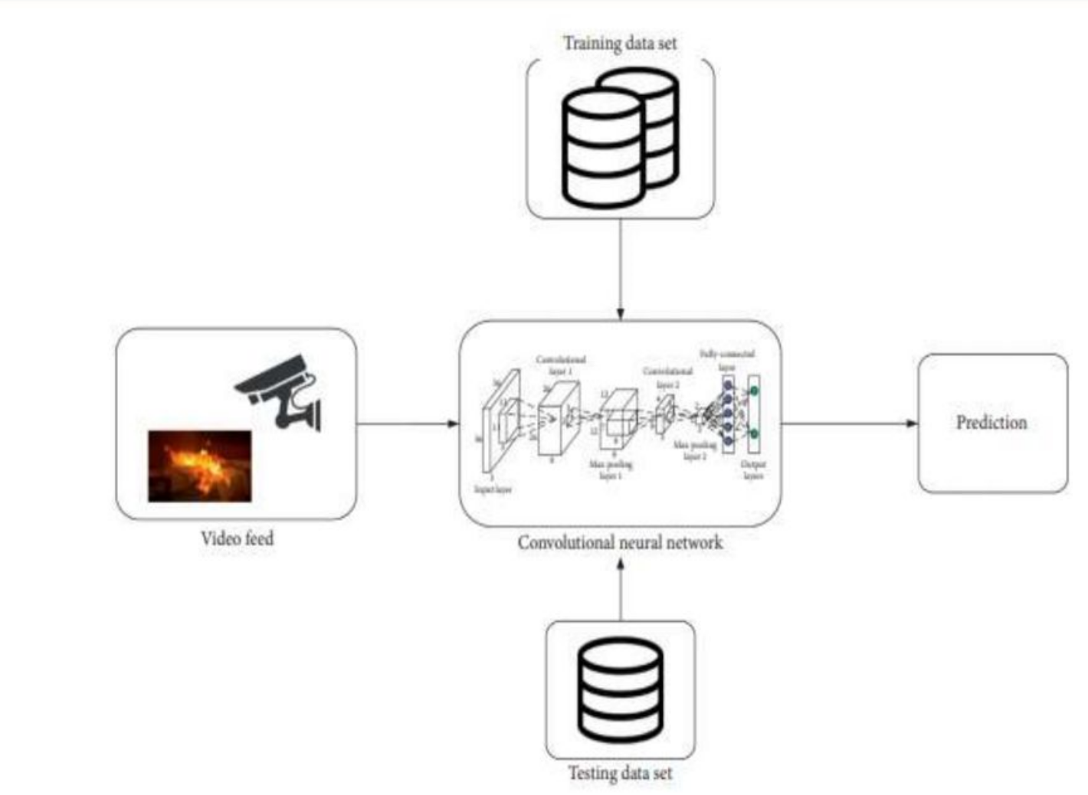
Architecture / Design

Slide 8
Data Set
Source of data set: https://archive.ics.uci.edu/ml/datasets/forest+fires

Slide 9
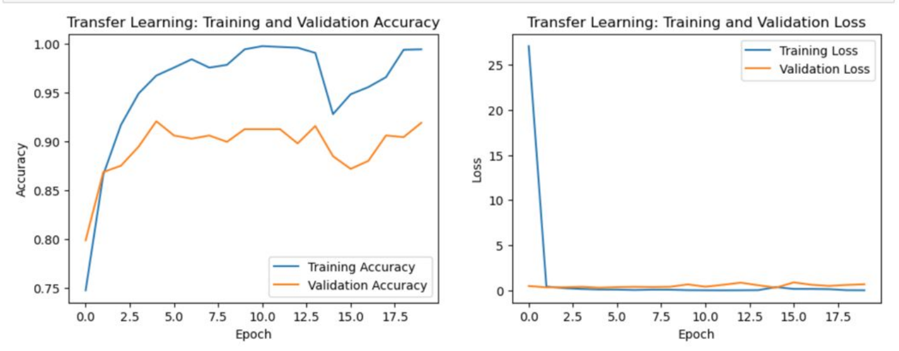
Implementation

Slide 10
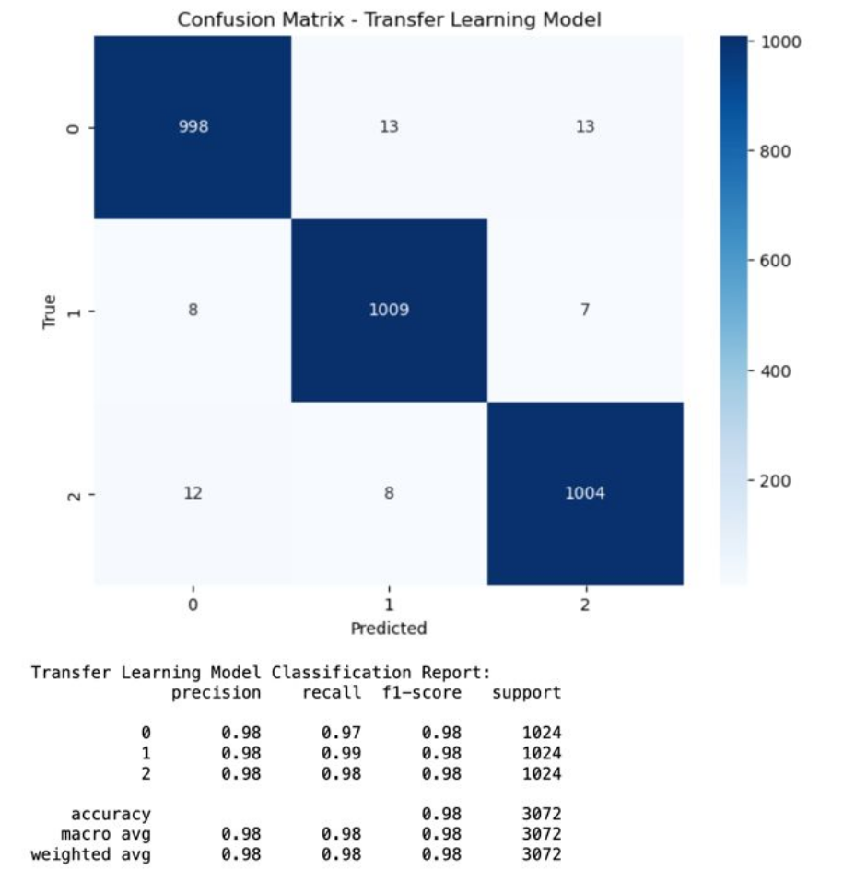
Implementation

Slide 11
MODELS IMPLEMENTED
CNN is specialized for analyzing visual data, using convolutional layers to detect features within images. It employs filters to convolve across the input, extracting spatial hierarchies and patterns, and often includes pooling layers to reduce dimensionality while retaining important information.
RNNs are designed to handle sequential data by retaining memory through loops, allowing information persistence over time. They're adept at processing sequences of inputs and are commonly used in tasks like language modeling, speech recognition, and time series prediction. However, they can struggle with capturing long-range dependencies due to vanishing or exploding gradients.
MLP is a feedforward neural network comprised of multiple layers, including an input layer, hidden layers, and an output layer. It's versatile and effective for various tasks, utilizing interconnected nodes with activation functions to process data and learn patterns.
CNN (Early Stopping)
ResNet 50 is a deep convolutional neural network architecture that includes 50 layers. It introduced the concept of residual learning, utilizing skip connections or shortcuts to bypass some layers. This approach helps in mitigating the vanishing gradient problem and allows for the training of very deep networks. ResNet-50 specifically comprises 50 convolutional layers, making it capable of handling complex visual tasks like image classification and object detection with improved accuracy and training efficiency compared to earlier architectures.
VGG (Visual Geometry Group) network is a convolutional neural network architecture that consists of 16 layers, including convolutional layers, pooling layers, and fully connected layers. VGG-16 is known for its simplicity and uniform architecture, employing smaller filter sizes (3x3) with multiple convolutional layers stacked together. Despite its deeper variants like VGG-19, VGG-16 is widely used and well-known for its ability to extract intricate features from images, making it effective in various computer vision tasks such as image recognition, localization, and segmentation.

Slide 12
MODELS IMPLEMENTED
GoogleNet, additionally referred to as Inception, is a deep convolutional neural community architecture advanced by way of Google. Introduced in 2014, GoogleNet is known for its inception modules, which employ a aggregate of convolutional filters of various sizes in the same layer. subsequent neural network designs and remains a noteworthy contribution to the field of deep gaining knowledge. We got the accuracy as 96.51%.
MobileNet is a convolutional neural network (CNN) architecture, introduced in 2018 specifically designed for efficient use on mobile and edge devices. We imported the model and additionally we used a dense layer and we got the accuracy as 97.14%.

Slide 13
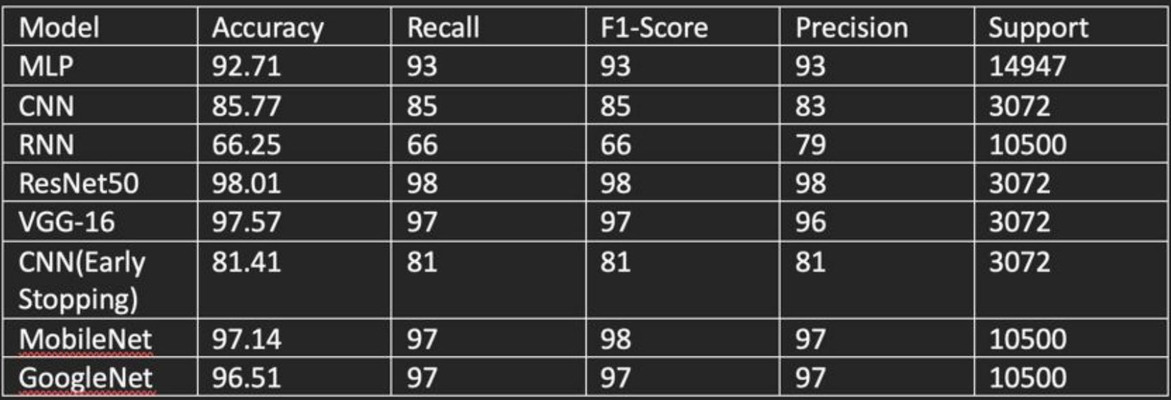
Implementation

Slide 14
Timeline
Literature Survey
Design
And
Code
Implementation
Testing
Document Submission
<1-10-2023>
<19-10-2023>
<15-11-2023>
<22-12-2023>
Abstract Submission
<11-09-2023>
<15-09-2023>

Slide 15
Conclusion
In our wildfire detection study, employing sophisticated neural network architectures led to remarkable accuracy findings.
Transfer Learning using ResNet50 showcased an exceptional 98.01% accuracy, demonstrating its adaptability to novel data by leveraging insights from extensive datasets.
Additionally, the utilization of Convolutional Neural Networks (CNNs) with Early Stopping yielded an impressive 96.64% accuracy, affirming its robustness in detecting wildfires by halting training at validation plateaus.
Integration of VGG-16 within our CNN model resulted in a notable 90.00% accuracy, benefiting from its deep architecture for detailed wildfire pattern extraction.
These outcomes collectively underscore the potency of advanced neural network approaches, offering significant promise for practical implementation in real-world wildfire tracking and response systems.

Slide 16
References
[1] Kalaivani, V., Chanthiya, P. (2022). A novel custom optimized convolutional neural network for a satellite image by using forest fire detection. Earth Science Informatics, 15(2), 1285–1295. https://doi.org/10.1007/s12145-022-00801
[2] B. Arteaga, M. Diaz and M. Jojoa, "Deep Learning Applied to Forest
Fire Detection," 2020 IEEE International Symposium on Signal
Processing and Information Technology (ISSPIT), 2020, pp. 1-6, doi:
10.1109/ISSPIT51521.2020.9408859
[3] I.Novac, K. R. Geipel, J. E. d. D. Gil, L. G. d. Paula, K. Hyttel and D. Chrysostomou, "A Framework for Wildfire Inspection Using Deep Convolutional Neural Networks," 2020 IEEE/SICE International Symposium on System Integration (SII), Honolulu, HI, USA, 2020, pp. 867-872, doi: 10.1109/SII46433.2020.9026244.
[4] Tzoumas, G., Pitonakova, L., Salinas, L. R., Scales, C. D., Richardson, T.,Hauert, S. (2022). Wildfire detection in large-scale environments using force-based control for swarms of UAVs. Swarm Intelligence, 17(1–2), 89–115. https://doi.org/10.1007/s11721-022-00218-9

Slide 17
References
[5] M. S. Khan, R. Patil and S. Ali Haider, "Application of Convolutional Neural Networks For WildFire Detection," 2020 SoutheastCon, Raleigh, NC, USA, 2020, pp. 1-5, doi: 10.1109/SoutheastCon44009.2020.9368283.
[6] S. Wu and L. Zhang, "Using Popular Object Detection Methods for Real Time Forest Fire Detection," 2018 11th International Symposium on Computational Intelligence and Design (ISCID), Hangzhou, China, 2018, pp. 280-284, doi: 10.1109/ISCID.2018.00070.
[7] X. Bai and Z. Wang, "Research on Forest Fire Detection Technology Based on Deep Learning," 2021 International Conference on Computer Network, Electronic and Automation (ICCNEA), Xi'an, China, 2021, pp. 85-90, doi: 10.1109/ICCNEA53019.2021.00029.
[8] U. Meena, G. Munjal, S. Sachdeva, P. Garg, D. Dagar and A. Gangal, "RCNN Architecture for Forest Fire Detection," 2023 13th International Conference on Cloud Computing, Data Science & Engineering (Confluence), Noida, India, 2023, pp. 699-704, doi: 10.1109/Confluence56041.2023.10048878.

Slide 18
THANK YOU

